Slide 1

Final Solution Presentation
Healthcare – Persistency of a Drug
6th November, 2023

Slide 2
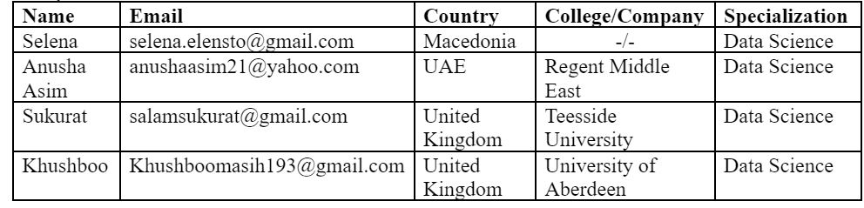

Internship Batch: LISUM24 Group: HealthData Collective Group Members:
GitHub Repo: https://github.com/venusflytrapfairy/HealthDataCollective-Group

Slide 3
Agenda
Background
Problem Statement
Approaches Used
Best Solution
Potential Implementations
Business Implications

Slide 4
Background – Pharmaceutical Industry
Pharmaceutical Industry Landscape: The pharmaceutical industry is a key player in global healthcare, dedicated to developing and delivering life-saving medications. Understanding patient medication persistency is pivotal for improving patient outcomes, informing marketing strategies, and ensuring the success of drug therapies.
HealthData Collective: The HealthData Collective is a group of international data science interns from diverse backgrounds. Our mission is to utilize data-driven insights to address pharmaceutical challenges and enhance patient care.
Project Objective: Our project focuses on automating the identification of patient medication persistency based on physician prescriptions. By leveraging machine learning, we aim to provide pharmaceutical companies with the tools to better understand and improve patient treatment adherence.
Key Stakeholders: The project serves the interests of pharmaceutical companies, healthcare providers, and most importantly, patients. Accurate insights into medication persistency can lead to better-informed decisions, ultimately improving healthcare outcomes.

Slide 5
Problem Statement & Business Implications
The problem to be solved is related to pharmaceutical companies' need to understand the persistence of drug usage among patients based on physician prescriptions. Specifically, the challenge is to automate the process of identifying whether a patient is persistent in following their prescribed therapy regimen. The primary problem is to build a classification model using machine learning to determine the persistence of patients based on various features and factors.
Business Implications:
Enhanced Patient Outcomes: Improving medication persistency directly contributes to better patient health outcomes. Pharmaceutical companies benefit from positive patient experiences and the potential for increased usage of their products.
Marketing Strategy Optimization: Accurate insights into medication persistency enable pharmaceutical companies to tailor marketing strategies. This leads to more targeted campaigns, ensuring that the right patients receive the right messages, thus optimizing marketing investments.
Treatment Efficacy Assessment: By automating the process of identifying medication persistency, pharmaceutical companies can evaluate the efficacy of their drugs in real-world settings. This data is invaluable for refining existing medications and developing new ones.
Cost Savings: Patients who adhere to their prescribed therapy regimens often require fewer medical interventions and hospitalizations. This leads to cost savings for both patients and healthcare systems, making medications more cost-effective in the long run.
Compliance Reporting: In many healthcare systems, pharmaceutical companies are required to provide compliance reports. Accurate medication persistency data simplifies compliance reporting and ensures companies meet regulatory requirements.
Improved Revenue: Patient persistency is directly linked to product revenue. Increased persistency can lead to higher product sales and revenue, while low persistency may necessitate product improvements or lifecycle management strategies.
Long-term Customer Loyalty: Improving medication persistency fosters patient loyalty. Patients who experience successful outcomes with a particular medication are more likely to remain loyal to the brand and continue using it for their healthcare needs.

Slide 6
Approaches Used
In our journey to enhance medication persistence in healthcare, we employed a range of data-driven approaches and machine learning models:
Data Profiling and Cleaning: We began by meticulously profiling and cleaning the dataset to ensure data accuracy and consistency.
Label Encoding: We prepared the dataset for modeling by encoding non-numerical features, making them machine-learning-ready.
Modeling Suite: Our toolkit featured various classification algorithms, each tailored to the dataset's unique characteristics.
Gaussian Naive Bayes: Leveraging Gaussian probability distributions for numerical features.
K-Nearest Neighbors (KNN): Utilizing instance-based learning for complex relationships.
Decision Tree Classifier: Mapping hierarchies of factors affecting persistence.
Support Vector Classifier (SVC): Creating optimal decision boundaries for binary classification.
Random Forest: Embracing versatility for mixed data types.
Oversampling Techniques: Addressing class imbalance using SMOTE, ADASYN, SMOTETomek, and SMOTEENN.
Evaluation Metrics: We assessed model performance with precision, recall, F1-score, and ROC AUC.
Log Normalization: A vital step for enhancing model accuracy.

Slide 7
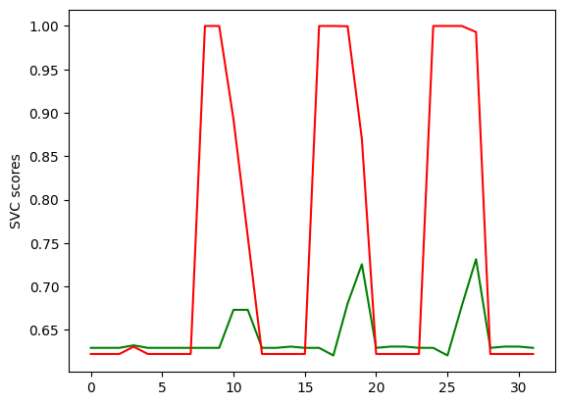
Best Solution: The Optimal Model for Predicting Medication Persistence
Our quest for the most effective model led us to the Support Vector Classifier (SVC).
A Binary Classification Champion: SVC excelled at distinguishing persistent and non-persistent patients.
Evaluation Metrics: SVC achieved impressive metrics, including an accuracy of 89.19%.
Balanced Accuracy: The balanced accuracy of 87.94% offers a fair view of model performance.
Precision and Recall: SVC effectively predicted both classes with precision and recall.
F1-Score: Balancing precision and recall, achieving an F1-score of 88.30%.
ROC AUC: Demonstrating the model's ability to distinguish between the two classes.

Slide 8


Potential Implementations: Innovating Healthcare
Beyond theoretical application, our model opens doors to innovative healthcare applications.
Medication Adherence Programs: Create tailored interventions to improve patient compliance.
Early Intervention: Identify non-persistent patients for proactive care and therapy adjustments.
Resource Allocation: Optimize healthcare resources by targeting at-risk patient groups.
Personalized Medicine: Tailor treatment regimens based on patient profiles and risk factors.
Clinical Trial Recruitment: Enhance patient selection for drug trials by understanding persistence.

Slide 9

Business Implications & Scope
Our model isn't just a tool, it's a strategic asset for healthcare providers and pharmaceutical companies.
Precision in Care: Improve patient outcomes by targeting interventions effectively.
Cost-Efficiency: Optimize resource allocation and reduce healthcare costs.
Market Insights: Gain a competitive edge by understanding patient behavior.
Drug Development: Accelerate clinical trials with well-defined patient groups.
Business Growth: Unlock new opportunities by leveraging medication persistence data.

Slide 10
☺
Thank You

